Slide 1
PythonDayThree -tuple and list with OOP
PoHanWu
20190201

Slide 2
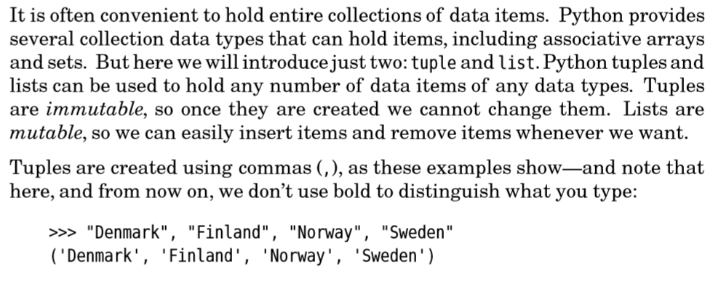

tuple and list

Slide 3
Add parentheses as an argument

Slide 4
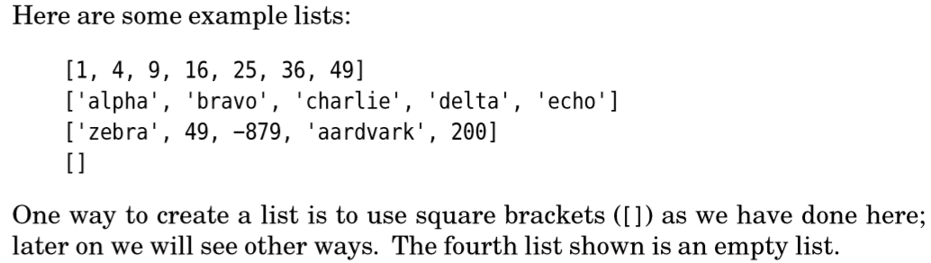
list

Slide 5
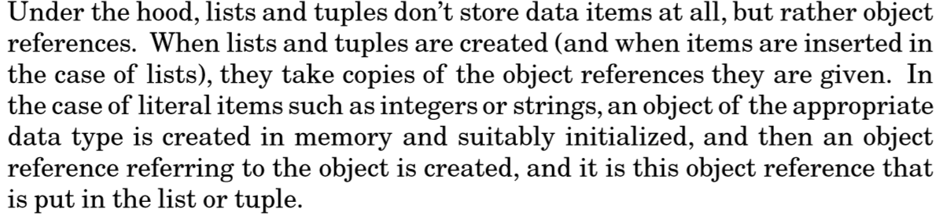
List and tuple take copy of object reference

Slide 6
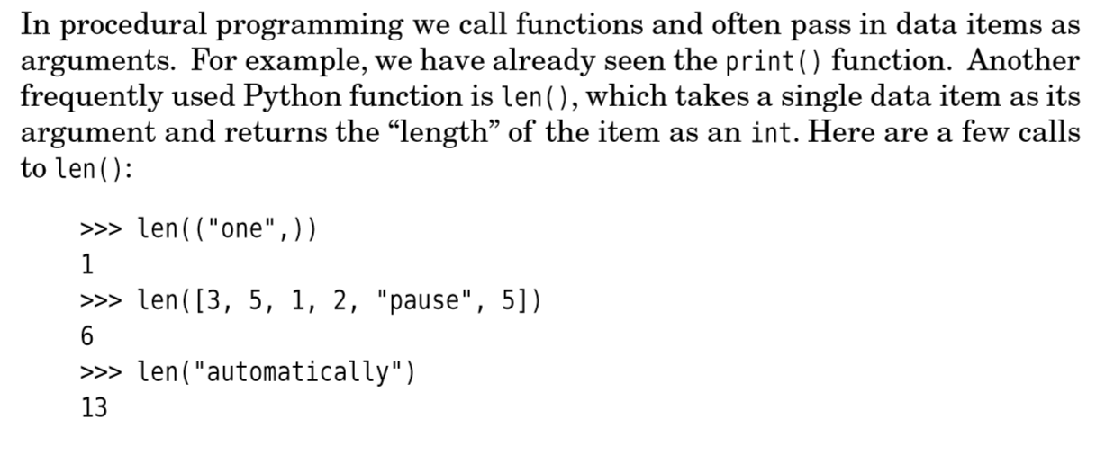
len()

Slide 7
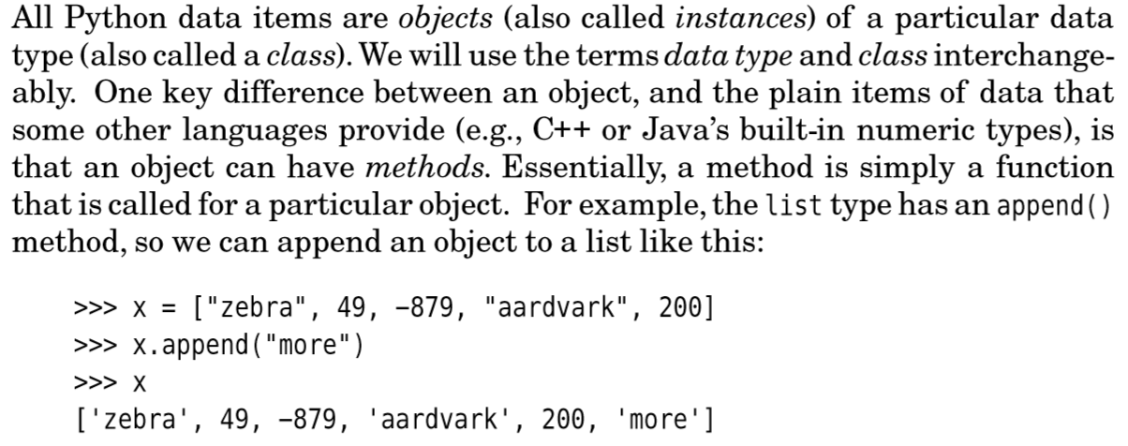
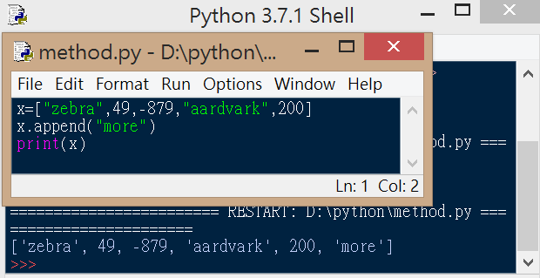
Object can have method ex:append(concept of OOP)

Slide 8
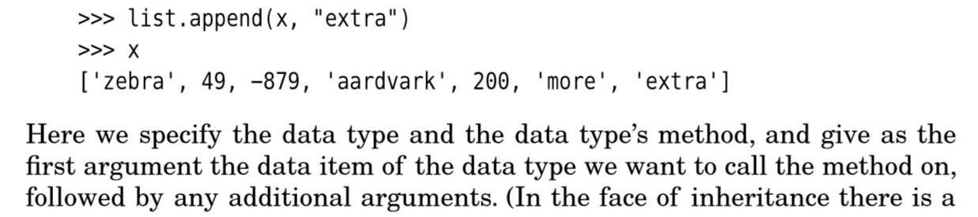
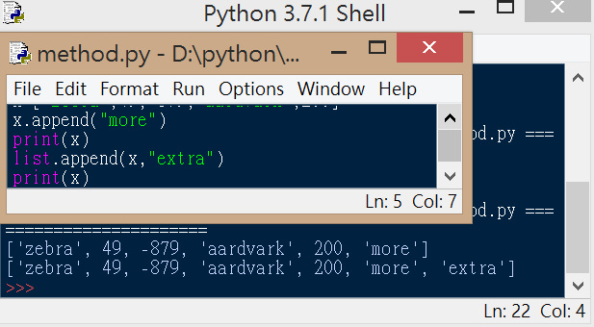
OOP class concept

Slide 9
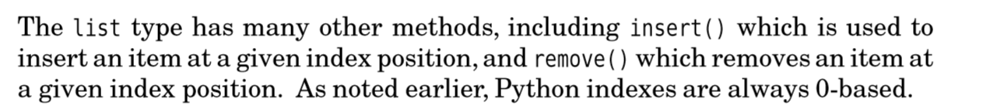
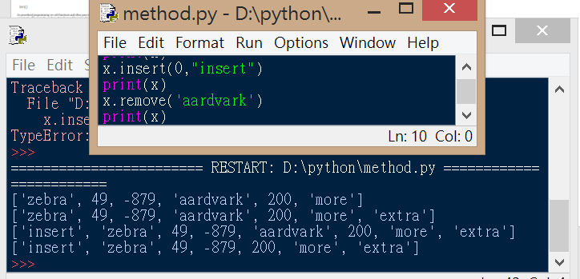
Insert() remove() page 21

